Slide 1
T130 Achievements T131 Target Goal Dream
TDK Philippines Corporation
A TDK Group Company
Laguna, Philippines
(BMS) DEVELOPMENT
Lans Jeffrey L. Galos

Slide 2
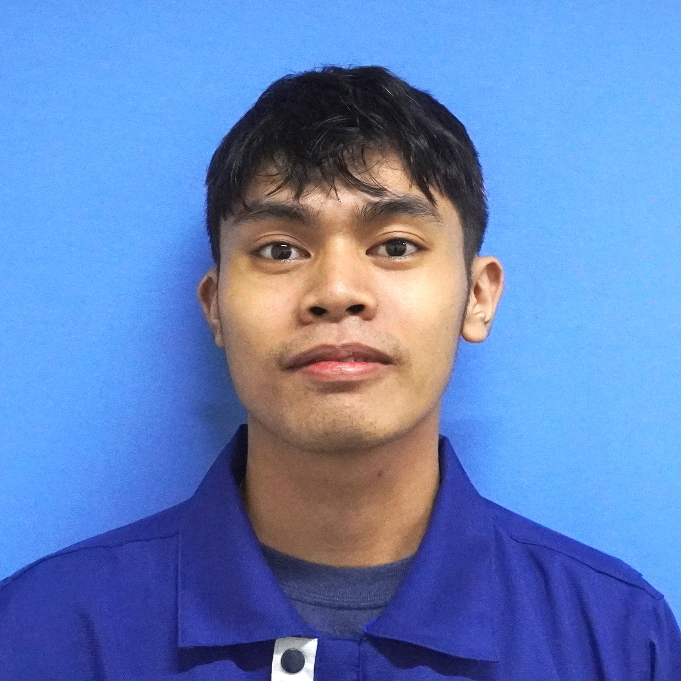
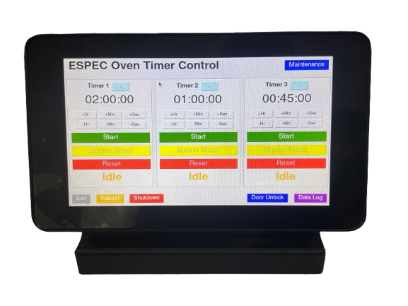
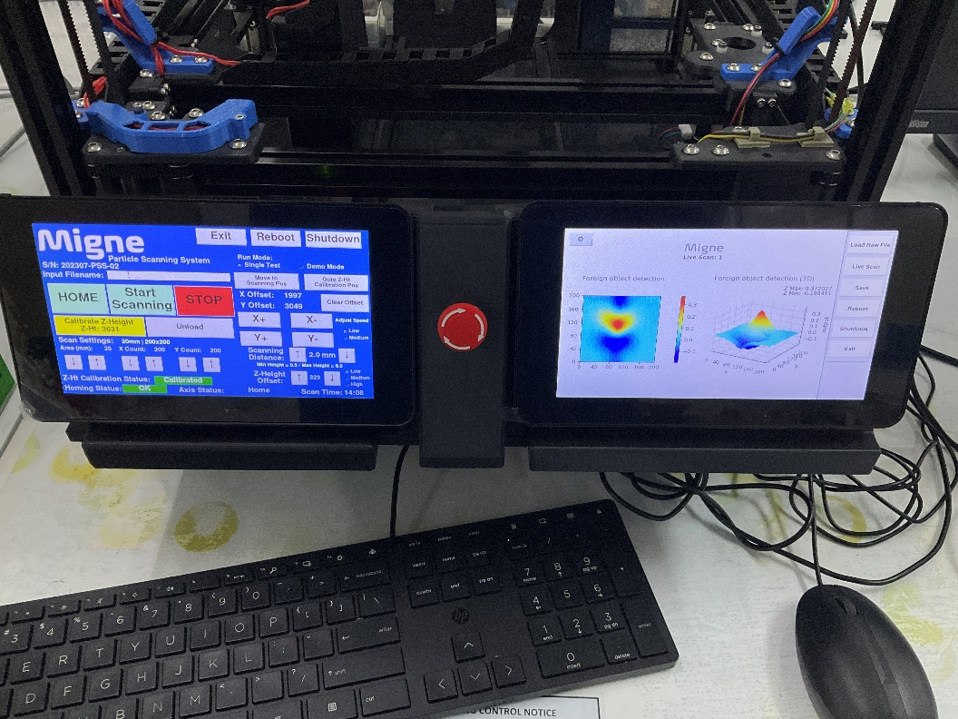
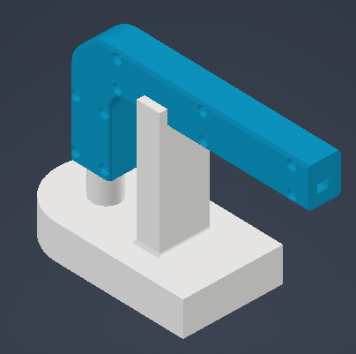
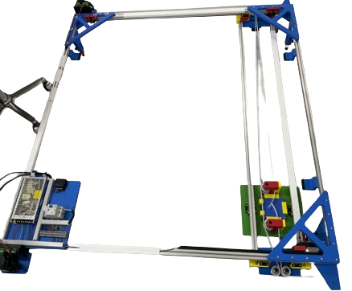
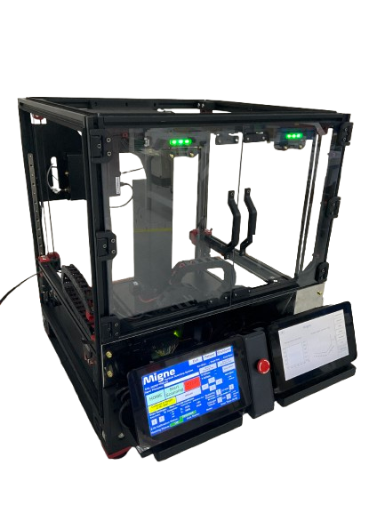
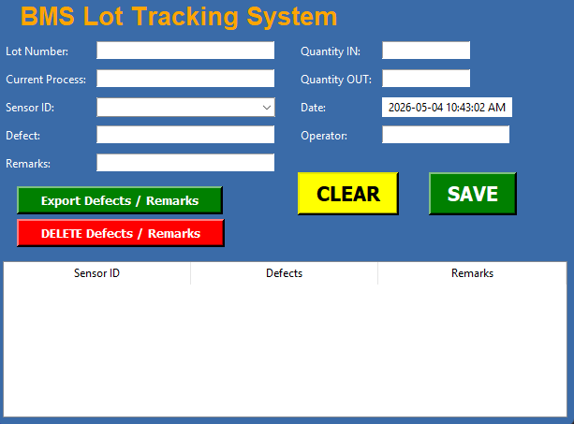
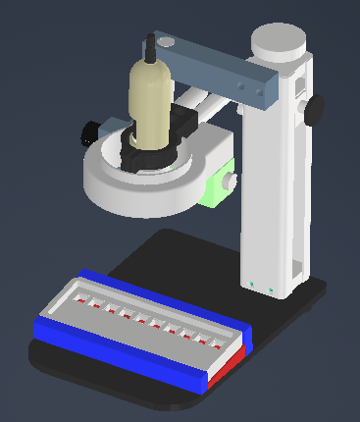
Lans Jeffrey L. Galos
Associate Technician
Core Skills:
System Programming
3D Design & Modelling
Embedded System Assembly
SYSTEM DEVELOPMENT | 3D DESIGN & ASSEMBLY
Oven Timer Program
Migne Scanning System Program
Laser Head Jig Holder
X&Y Wall Scanning Machine
OCR Camera Fixture
Migne Scanning System
Lot Tracking System

Slide 3
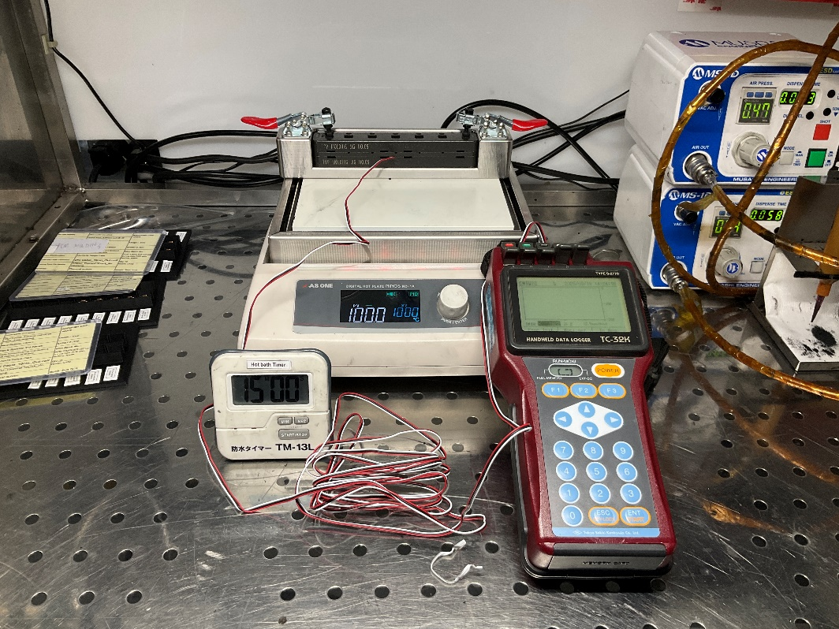
T130 Achievements
Items |  | Purpose | Status
ESPEC Oven Timer Program |  | To have a multiple timer of each condition | Done
Strain Measurement for Migne PCB |  | To measure strain (deformation) of Migne PCB | Done
Migne Scanning System Program Modification |  | To modify overall functions of the system | Done

Slide 4
T130 Achievements
Items |  | Purpose | Status
Metal Particle Detection for Plate & Pellet |  | To evaluate the sensor’s performance | Done
Lot Tracking System 1st Trial |  | To easily track and store data of sensors throughout the process | Done

Slide 5
T131 Target Goal
Target Item | Target Goal | Actual | Target Date
Lot Tracking System 2nd Trial Run | 100% | 0% | T131-Q1
Dino-Lite OCR Camera Improvement | 100% | 50% | T131-Q1
Exposure to 3D Designing | 100% | 20% | T131-Q4

Slide 6

My Dream for BMS
I aspire for BMS to become a successful and continuously growing business
My Dream for Myself
I aspire for myself to become successful and professional person
This Photo by Unknown Author is licensed under CC BY-SA

